Slide 1

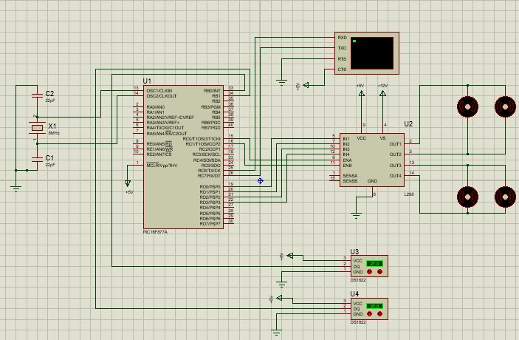
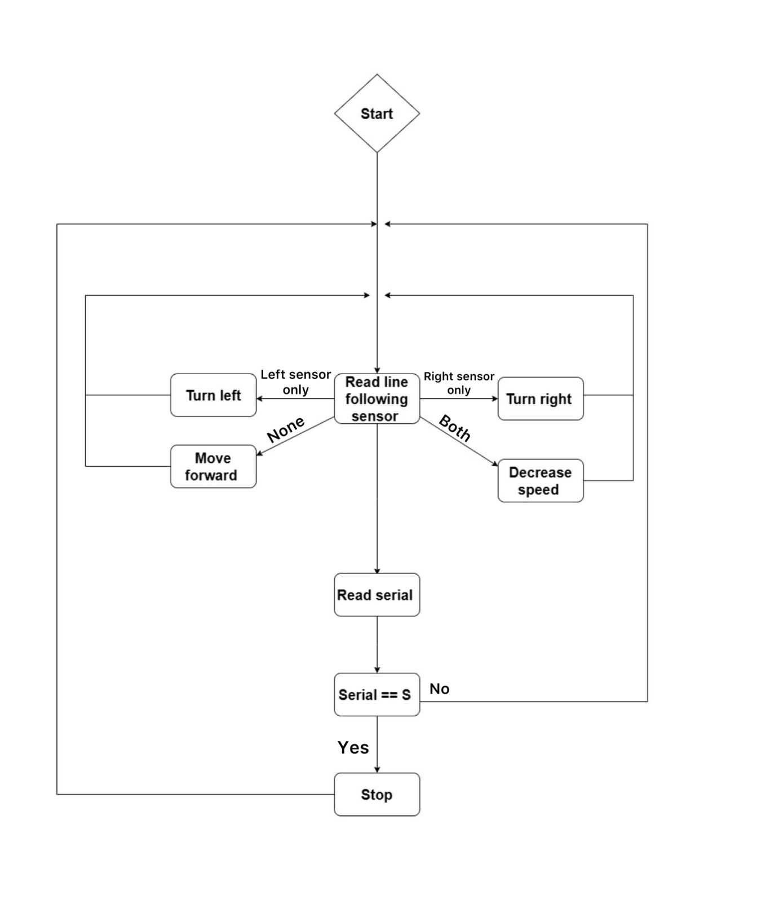
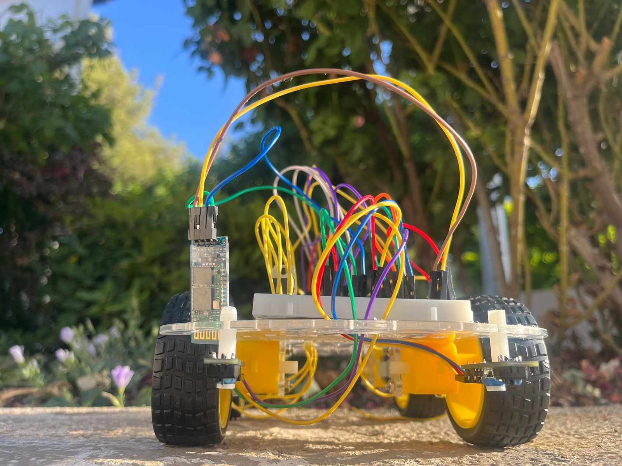
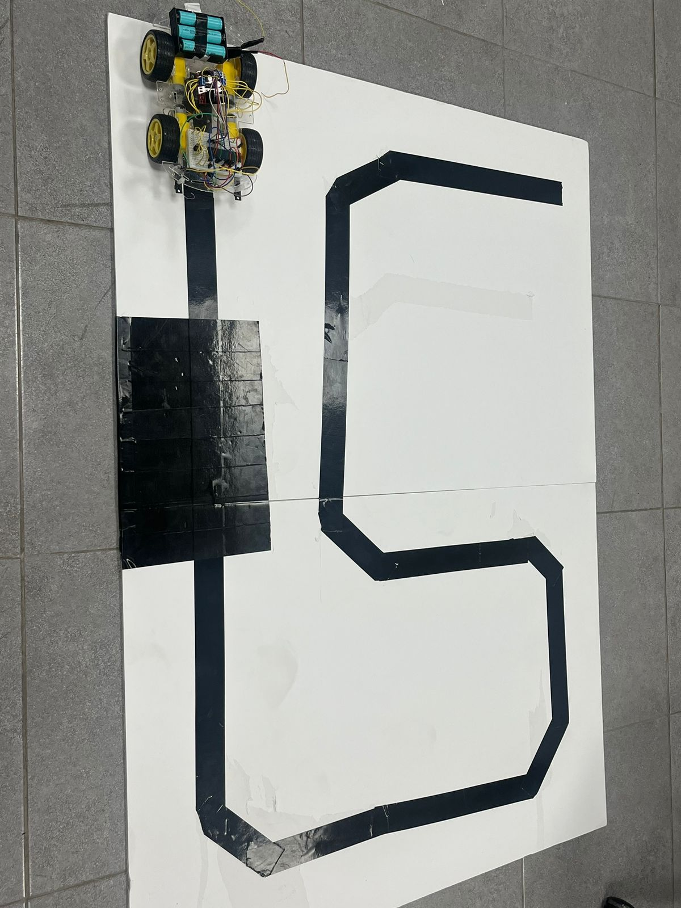
Line Following Car
F.alkhatib, L. Abdeen, N. Abushakara
Supervisor: Dr. Belal Sababha Embedded Systems Final Design Project, Fall 2023 King Abdullah II School of Engineering
Princess Sumaya University for Technology
Design
Our project was designed by pic16f877a that control a car which consist of two line following sensors , H-bridge , DC motors and hc-06 Bluetooth module
Introduction
This project involves creating a line-following car using the PIC16F877A microcontroller. The car is designed to autonomously follow a black line on the surface using two line following sensors. When both sensors detect the black line, the car reduces its speed for precise navigation. Additionally, the car can be remotely stopped via Bluetooth upon receiving the "S" command.This embedded systems project demonstrates the capabilities of the PIC16F877A microcontroller in developing an intelligent and responsive line-following car.
Results
The project aimed to design and implement a line-following car using a PIC16F877A microcontroller and a Four-wheeled differential drive system. The car was equipped with line following sensors to detect a black line on the surface and perform corresponding movements based on the sensor readings.
Figure 1: Electrical design
Figure 3. Final mechanical Design
Figure 2: Software Design
Figure 4. Track
Conclusion
In conclusion, the line-following car project successfully implemented a PIC16F877A microcontroller and a Four-wheeled differential drive system to track and follow a black line. The car demonstrated accurate movements, precise turns, and maintained a consistent speed. Future improvements could focus on enhancing line detection for faint lines and exploring additional functionalities such as obstacle detection and wireless control. Overall, this project lays the groundwork for further advancements in autonomous vehicle technologies.

